Slide 2
The first recorded Olympic Games was held in Olympia, Greece in 776BC.

Slide 3
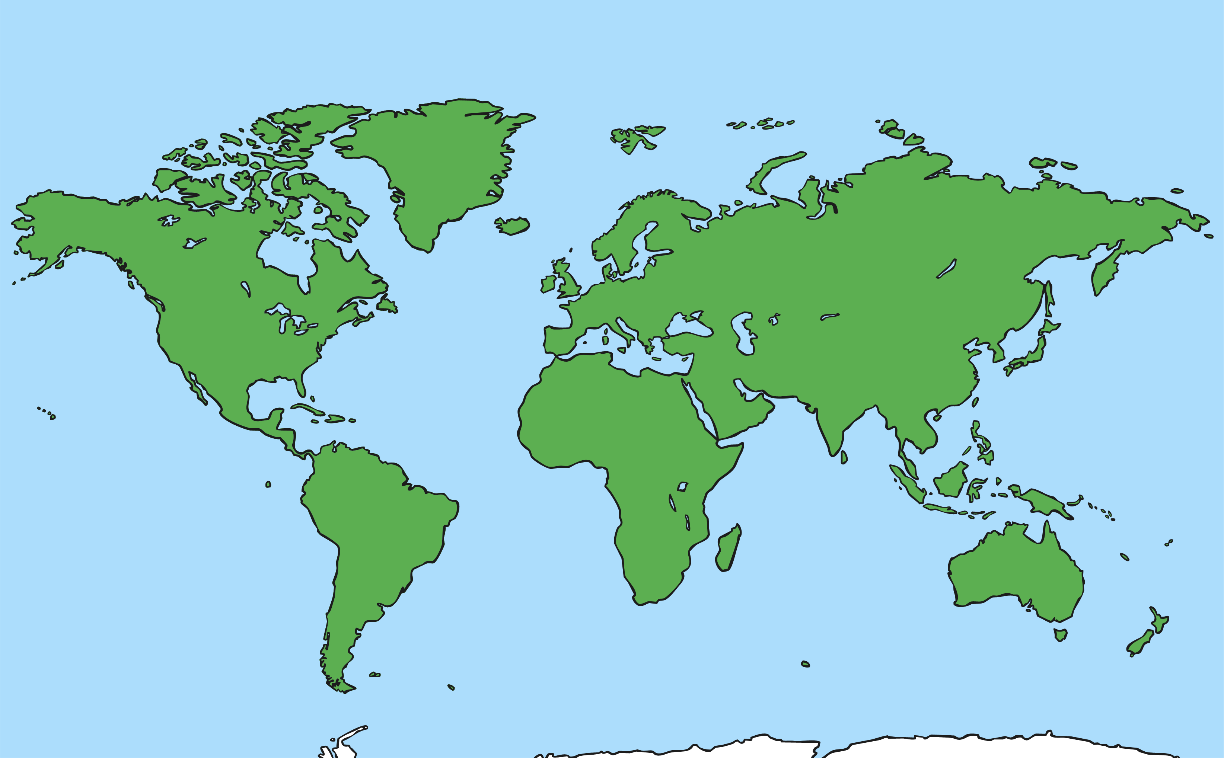
The Games were held every four years, as they are today.
Back then it was only held in Olympia, whereas now it is held in a different country around the world each time.

Slide 4
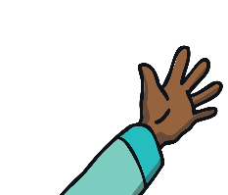


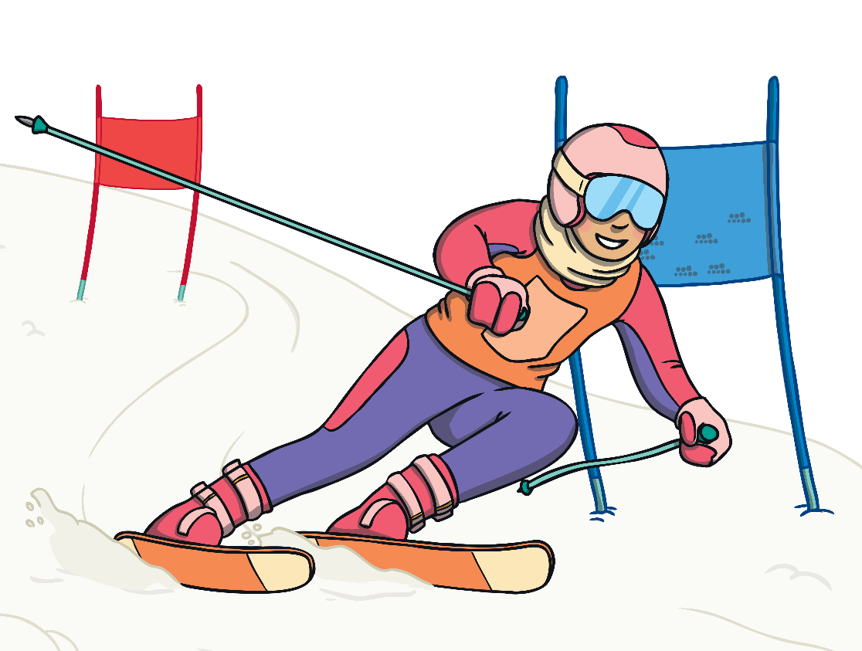
Today, as well as the Summer Olympics, the Winter Olympics are held two years after the Summer Games.

Slide 5
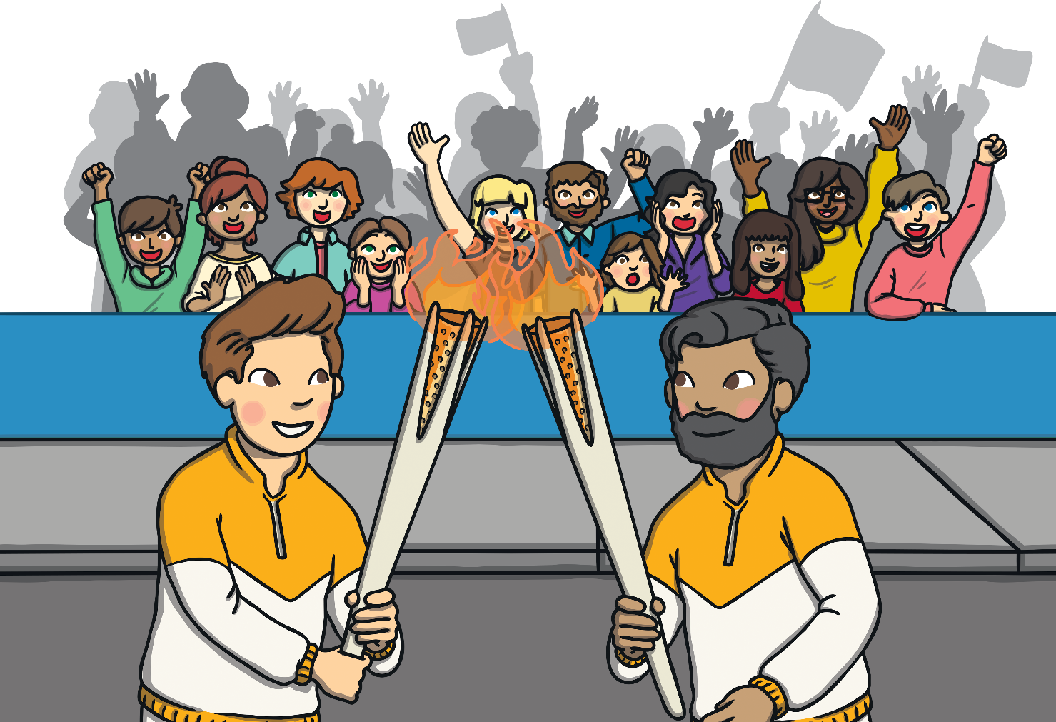
To symbolise the Ancient Olympics, the torch is carried around the country of the Games.

Slide 6
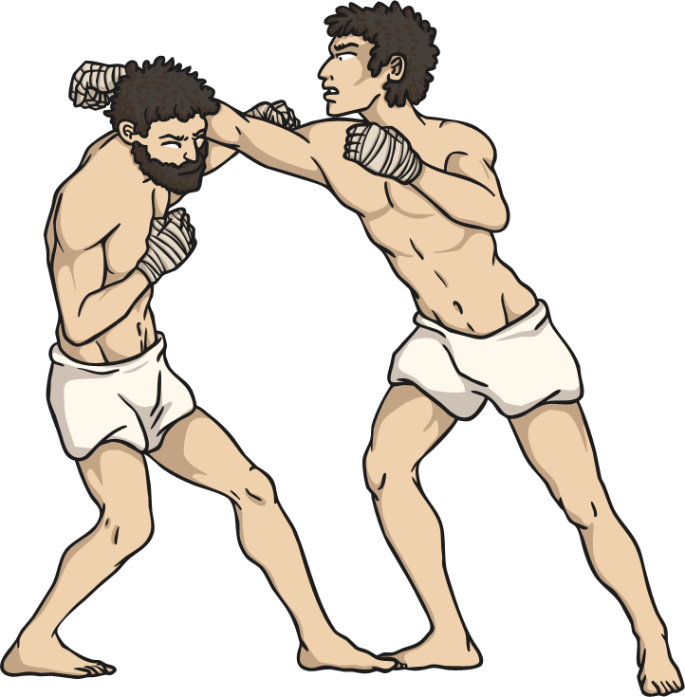
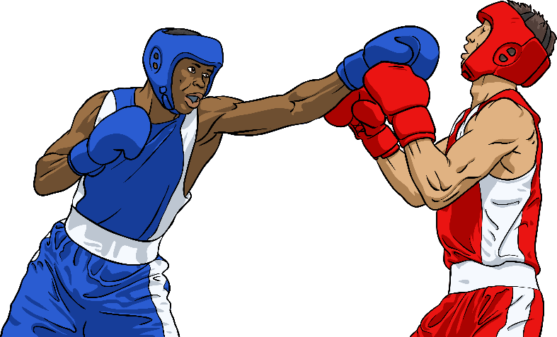

Ancient Olympics
Modern Olympics
In the Modern Olympics there are more than twenty different sports.
In the Ancient Greek Olympics there were only ten sports.

Slide 7
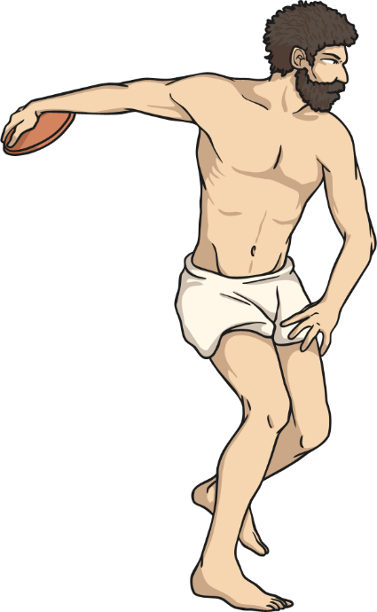
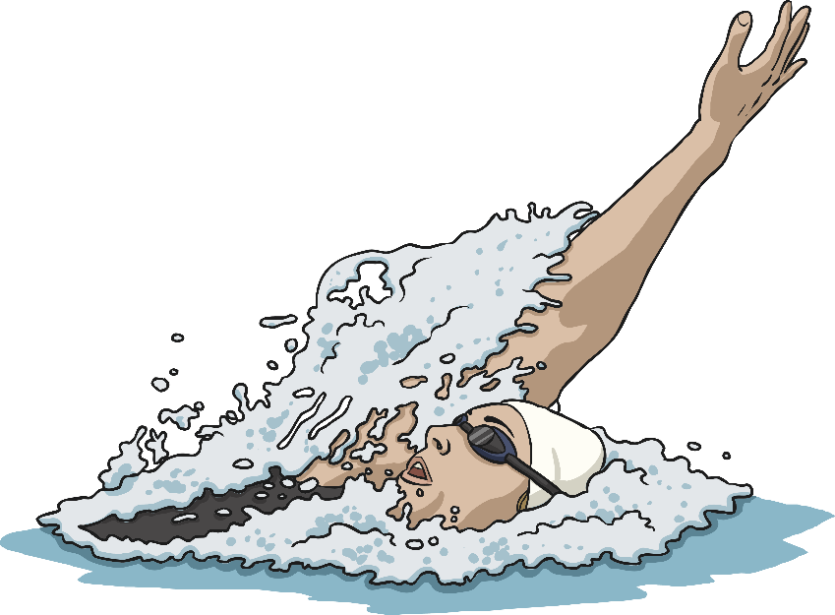
Ancient Olympics
Modern Olympics
The pentathlon consisted of running, wrestling, long jump, discus and javelin.
The modern pentathlon is made up of pistol shooting, fencing, swimming, showjumping and a cross-country run.

Slide 8
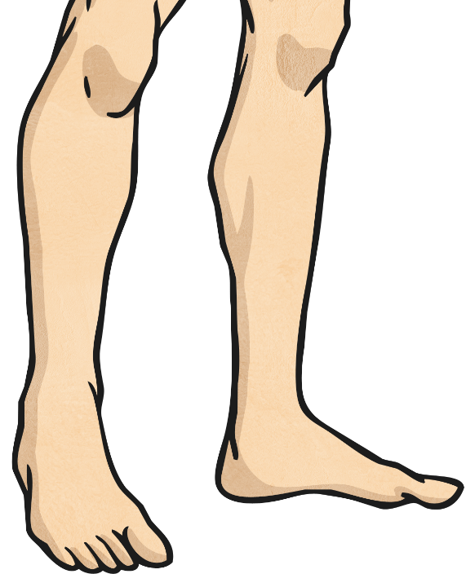
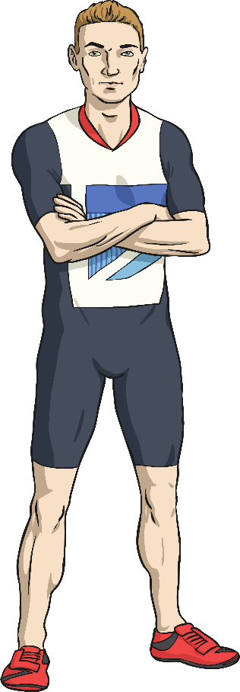
Ancient Olympics
Modern Olympics
Athletes ran barefoot and wore no clothes.
Track runners today wear special shoes that have spikes to help them grip.

Slide 9
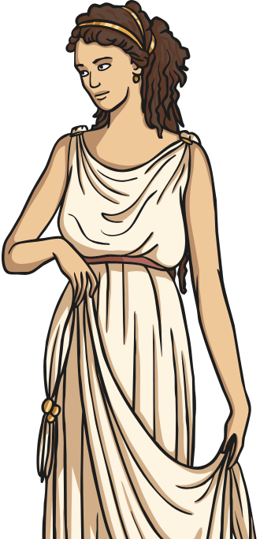
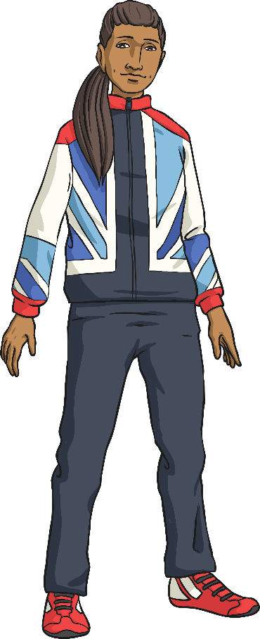
Ancient Olympics
Modern Olympics
Women were not
allowed to watch or compete in the Games.
Women and men both take part, but they do not compete against each other

